Slide 1
Study Group: Simulation
OFFICIAL : SENSITIVE
GFSA Autumn Quarterly

Slide 2
Agenda
OFFICIAL : SENSITIVE
Simulation overview
What is a Simulation?
Why use Simulation?
How do we build a Simulation?
Key Simulation techniques
Monte Carlo simulation
System dynamics
Discrete event simulation
Agent-based modelling
3. Case Study: Crown Court backlog
XX

Slide 3
What is Simulation?
OFFICIAL : SENSITIVE
The representation of the system via objects and activities
“The process of mathematical modelling, performed on a computer, which is designed to predict the behaviour of, or the outcome of, a real-world or physical system”
Allows us to answer “what if” questions about the system under different scenarios
The underlying process which the modeller is looking to replicate

Slide 4
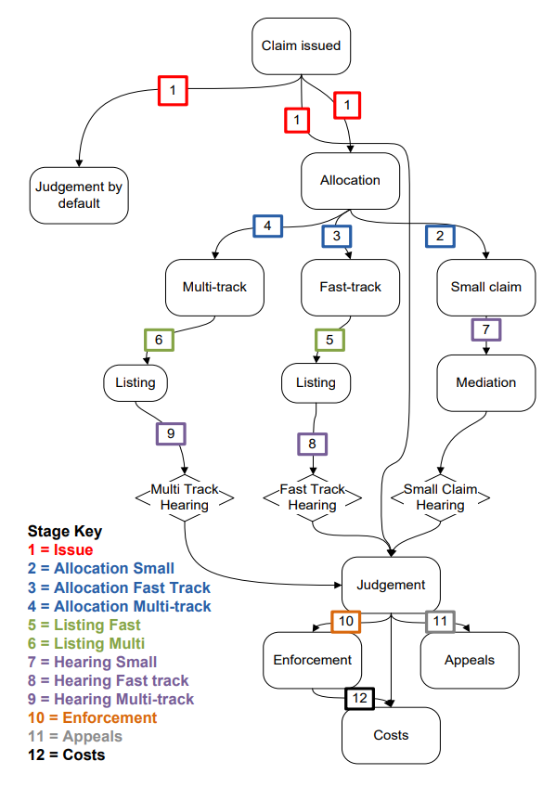
Examples of simulation in government?
OFFICIAL : SENSITIVE
Many OR projects that look at large, complex systems can be modelled (with relative ease) by using simulation.
For example, these could be used in government for modelling:
Waiting lists (NHS waiting times, backlog in courts, asylum applications)
Processes (NHS treatment pathways, navigating the courts, applying for visas)
Costs
These can usually be displayed through flow charts, or at least visually!
The example on the right is taken from the GORS project catalogue on court case progression.

Slide 5
How do we go about building a simulation?
OFFICIAL : SENSITIVE
1. Simulation Design
What type of simulation do we need for
our system?
2. Data Collection & Parametrization
Which parameters should our model have?
3. Output Analysis & Validation
Does the model accurately reflect the system?
4. Experimentation
How does the model perform under different scenarios?
5. Sensitivity Analysis
What effect does the changing of parameters
have on our outputs?

Slide 6
Why use Simulation?
OFFICIAL : SENSITIVE
Advantages
The simplicity of its concept allows straightforward explanation of the analysis to stakeholders or customers
Particularly useful for detecting bottlenecks and testing methods to increase system flow
The time horizon of the study can be adapted with ease
Easily adaptable, it allows us to ask and answer “what if” questions, which often isn’t possible in right life
Easy to produce confidence intervals
We can set and test arbitrary assumptions easily
We can use real-world observations to influence our models using different statistical distributions
To be aware of
Randomness involved means that sophisticated output analysis is required to draw meaningful conclusions
A mathematically optimal solution is never found
Quality of the simulation dictated by quality of the input data – gathering of accurate and reliable data can be difficult and time-consuming

Slide 7
Which type of Simulation do I need?
OFFICIAL : SENSITIVE
System model
Parameters known or variable?
Deterministic
Stochastic
Time frame?
Static
Dynamic
Static
(Monte Carlo)
Dynamic
When can the state of the system change?
Discrete
Continuous
Discrete
(Discrete event)
Stochastic

Slide 8
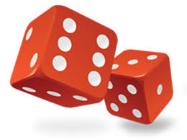



What are key Simulation techniques?
OFFICIAL : SENSITIVE
Monte Carlo simulation
System dynamics
Discrete event simulation
Agent-based modelling

Slide 9

Monte Carlo: multiple probability simulation
OFFICIAL : SENSITIVE
Uses repeated random sampling to obtain the likelihood of a range of results occurring.
Invented during World War II to improve decision making under uncertain conditions
Builds a model of possible results by leveraging a probability distribution for any variable which has inherent uncertainty. Recalculating the results over and over – often thousands of times – yields the probability of each result occurring.
Simple application: Rolling two dice and predicting the sum – 36 different combinations – can manually calculate the probability of each. Simulating rolling the dice 10,000 times, using Monte Carlo, will yield a probability distribution for each sum.
https://www.ibm.com/topics/monte-carlo-simulation
Notes:
A type of computational algorithm which uses repeated random sampling to obtain the likelihood of a range of results occurring.
One simple example of a Monte Carlo Simulation is to consider calculating the probability of rolling two standard dice. There are 36 combinations of dice rolls. Based on this, you can manually compute the probability of a particular outcome. Using a Monte Carlo Simulation, you can simulate rolling the dice 10,000 times (or more) to achieve more accurate predictions.

Slide 10
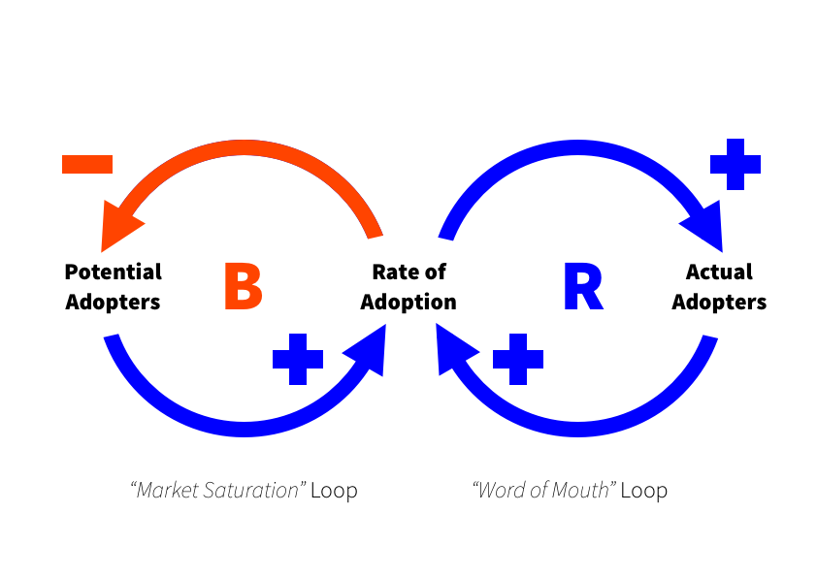
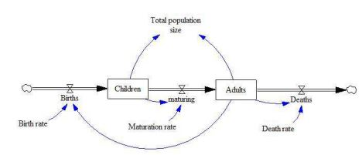

System Dynamics: stocks and flows
OFFICIAL : SENSITIVE
Approach to understanding the nonlinear behaviour of complex systems over time using stocks, flows, internal feedback loops, table functions and time delays
Originally developed in the 1950s by an MIT professor, to help corporate managers improve their understanding of industrial processes
Causal loops often a starting point for understanding the system to be modelled, by visualising their behaviour and structure
Stock and flow diagrams then used to analyse the system and as a basis for design of the model
Differential equations utilised to calculate the flow of stocks within the simulation
Simple application: Growth/decline of a population, as the sizes of different ‘pockets’ of the population change over time.

Slide 11
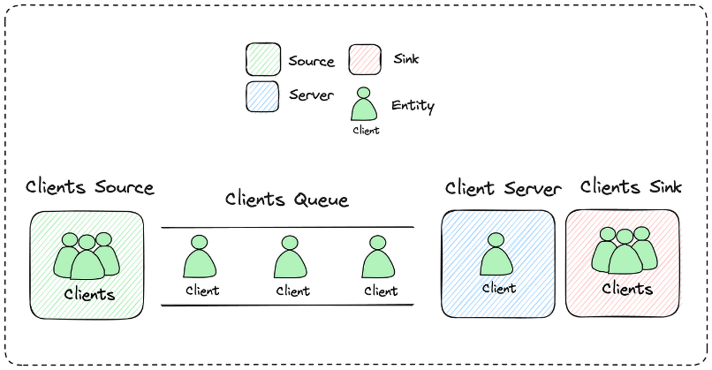
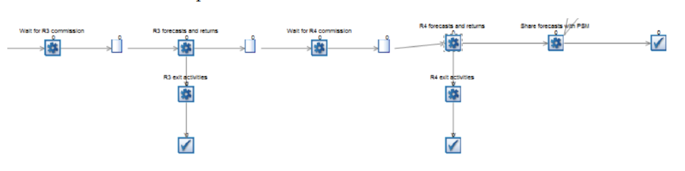
Discrete Event simulation
OFFICIAL : SENSITIVE
Models the behaviour of a system as a discrete sequence of events in time, each of which changes the state of the system in some way
Characterised by a series of activities, queues and resources, where the flow of items through the simulation can then be studied
Parameters for the length of time taken by activities and the number of resources available often given by random variables
Components of a DES: state; clock; events list; random number generators; ending condition
Simple application: a queuing system, such as customers arriving at a bank teller, where each customer is served in a time according to a given distribution
Notes:
Visual software like Simul8 often used for DES, where activities and queues can be seen in order

Slide 12
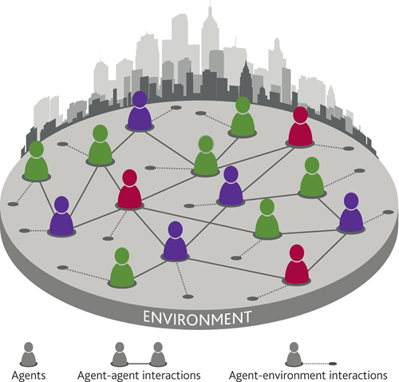

Agent-based modelling
OFFICIAL : SENSITIVE
Explains the behaviour of a system by simulating the behaviour of each individual ‘agent’ within it
Often utilised in ecology & economics
Focuses directly on individual objects / agents, their behaviour, and their interaction – rather than on the population split into pockets (as in system dynamics) or on the set of processes within a system (discrete event)
Agent-based models nowadays often utilise real, personalised data on the properties and behaviours of individuals
Simple application: modelling how the behaviour of each individual fish creates the seemingly organised and unpredictable movements of the shoal
https://www.bankofengland.co.uk/-/media/boe/files/quarterly-bulletin/2016/agent-based-models-understanding-the-economy-from-the-bottom-up.pdf
https://www.anylogic.com/use-of-simulation/agent-based-modeling/
Notes:
Shows how even very simple behaviours can combine from the ‘bottom up’ to recreate more complex behaviours of systems seen in the real world

Slide 13
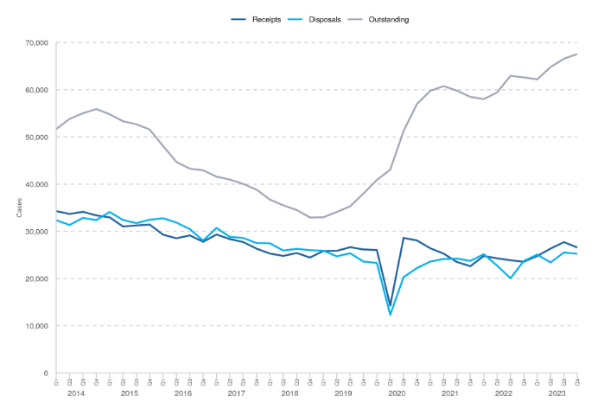
Case study – Crown Court Backlog
Criminal court statistics quarterly: October to December 2023

Slide 14
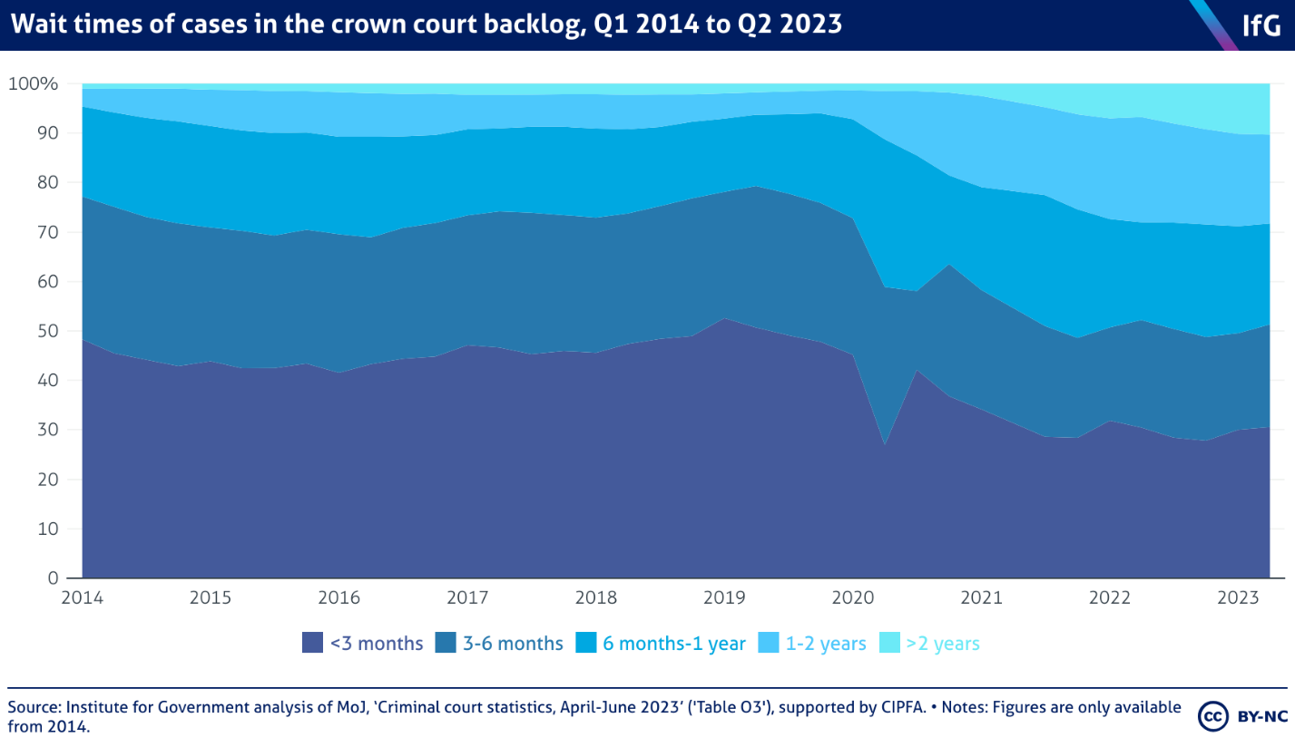
Why simulation?
Forecast what might happen:
under status quo
if changes are made (scenario analysis)
Answer distributional questions (“what % of cases will have a wait time >6 months?”)

Slide 15
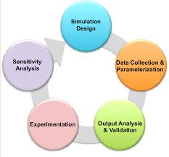
Case study - steps
Understand system
Decide on appropriate simulation
Simulation design
Data collection and parameterisation
Output analysis and validation
Experimentation
Sensitivity analysis
Iterate

Slide 16
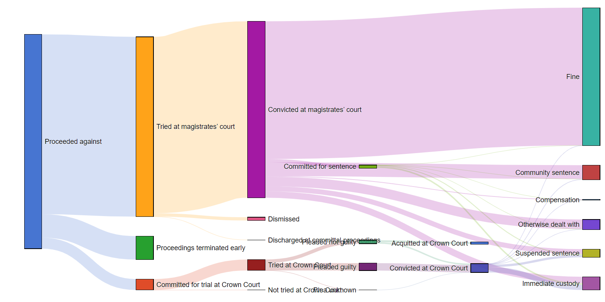
Understand system
Understand system
Decide on appropriate simulation
Simulation design
Data collection and parameterisation
Output analysis and validation
Experimentation
Sensitivity analysis
Iterate

Slide 17
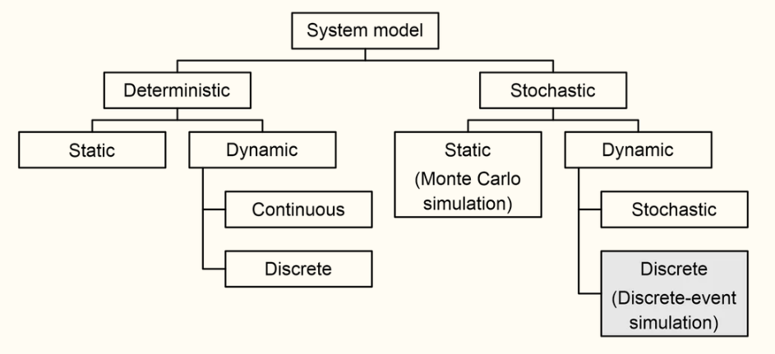
Decide on appropriate approach
Understand system
Decide on appropriate simulation
Simulation design
Data collection and parameterisation
Output analysis and validation
Experimentation
Sensitivity analysis
Iterate
Interested in understanding :
uncertainty and range of outcomes -> stochastic simulation
trajectory of system over time -> dynamic
-> Discrete event simulation

Slide 18
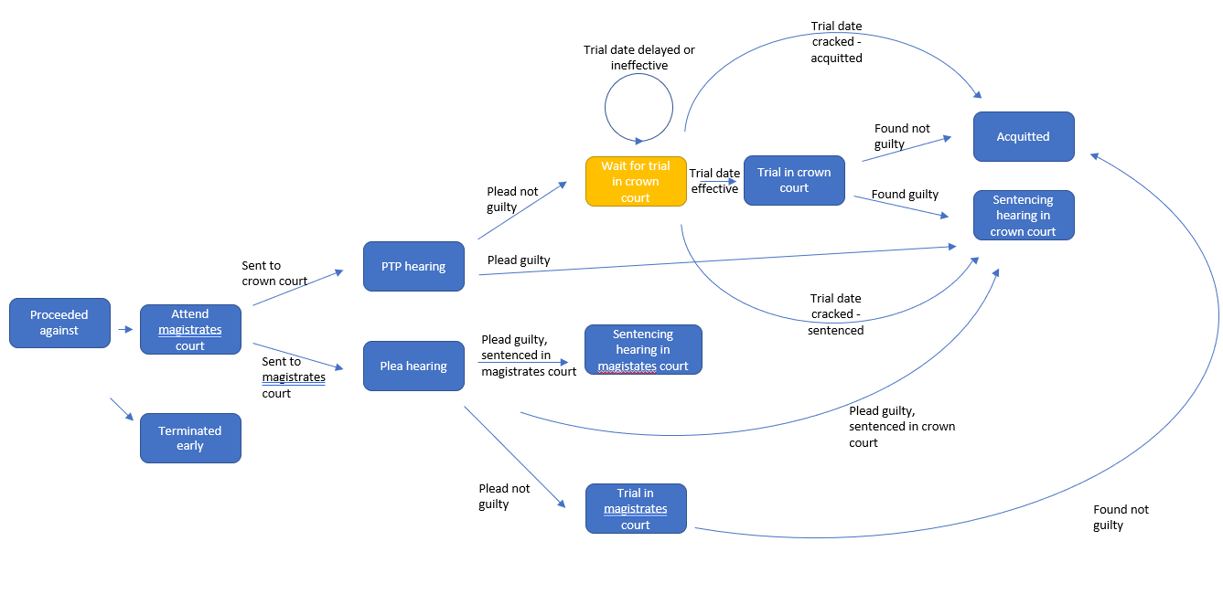
Simulation design
Understand system
Decide on appropriate simulation
Simulation design
Data collection and parameterisation
Output analysis and validation
Experimentation
Sensitivity analysis
Iterate

Slide 19
Data collection
Understand system
Decide on appropriate simulation
Simulation design
Data collection and parameterisation
Output analysis and validation
Experimentation
Sensitivity analysis
Iterate

Slide 20
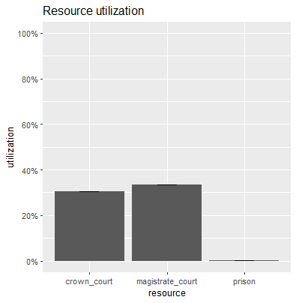
Analyse outputs
Understand system
Decide on appropriate simulation
Simulation design
Data collection and parameterisation
Output analysis and validation
Experimentation
Sensitivity analysis
Iterate
simmer environment: CrownCourtsSim | now: 100 | next: 100.000312880018
{ Monitor: in memory }
{ Resource: crown_court | monitored: TRUE | server status: 90(281) | queue status: 0(Inf) }
{ Resource: magistrate_court | monitored: TRUE | server status: 947(2810) | queue status: 0(Inf) }
{ Resource: prison | monitored: TRUE | server status: 61(50000) | queue status: 0(Inf) }
{ Source: cases | monitored: 1 | n_generated: 24476 }
We have a couple of conclusions:
With our initial conditions/assumptions, blockages in our simulation come from the courts, in particular the magistrates’ court
This simulation shows there is capacity across the full system

Slide 21
Experimentation
Understand system
Decide on appropriate simulation
Simulation design
Data collection and parameterisation
Output analysis and validation
Experimentation
Sensitivity analysis
Iterate

Slide 22
Sensitivity analysis
Understand system
Decide on appropriate simulation
Simulation design
Data collection and parameterisation
Output analysis and validation
Experimentation
Sensitivity analysis
Iterate

Slide 23
Iterate
Understand system
Decide on appropriate simulation
Simulation design
Data collection and parameterisation
Output analysis and validation
Experimentation
Sensitivity analysis
Iterate

Slide 24
Lessons learned
Obstacles/pitfalls
Technical stuff – simmer package etc
…

